Slide 1
EMERGENCY MEDICARE
GROUP-7
GROUP MEMBERS:
Faiza Tasnim-(19-41552-3)
Syeda Faiza Karima-(20-43073-1)
Sharia Tasnim Adrita-(20-41895-1)
Sadia Afrin Sara – (20-41834-1)

Slide 2
Contents:
Requirement planning
Use Case Diagram
Activity Diagram
Class Diagram
User Story Card
UI Design
Jira
Git
Timeline Chart
Constructive Model

Slide 3
Requirement planning:
Purpose: The main purpose of our project is to provide immediate ambulance service as well as prescribed necessary imported medicine delivery facilities. This project attempts have been made to make this project as user friendly as possible. Interfaces are very clear and simple hope that anyone can use it easily.
Functions:
On-time availability of ambulances from any area.
Provides flexibility to choose required ambulance depending on the patient’s condition.
Sample collection and online report delivery system within 24hrs.
All kinds of medicines including imported medicine delivery followed by the required prescription.

Slide 4
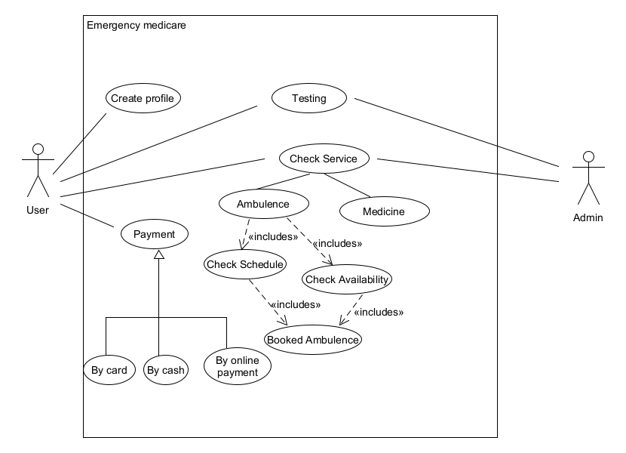
USECASE DIAGRAM:

Slide 5
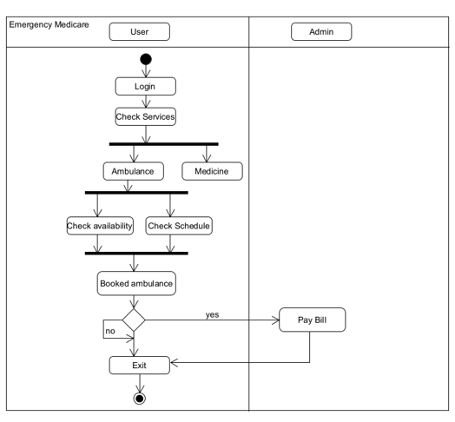
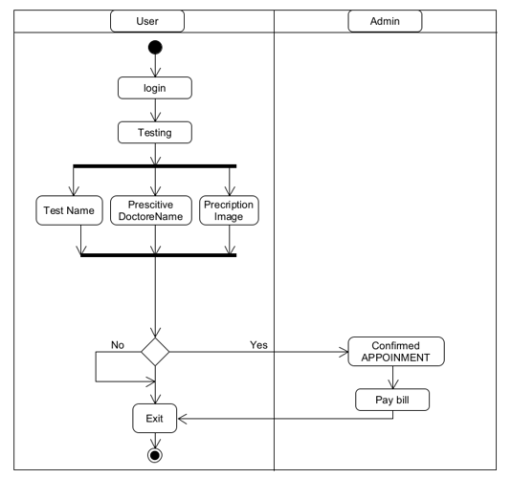
Activity diagram:

Slide 6
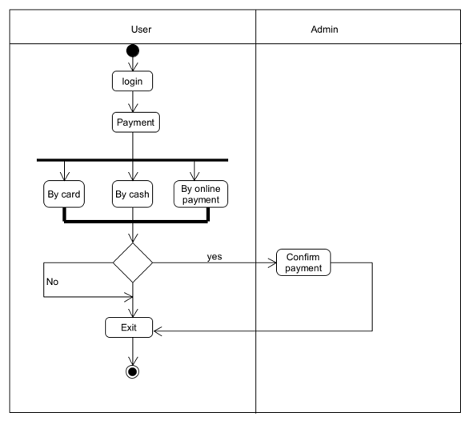
Activity diagram:

Slide 7
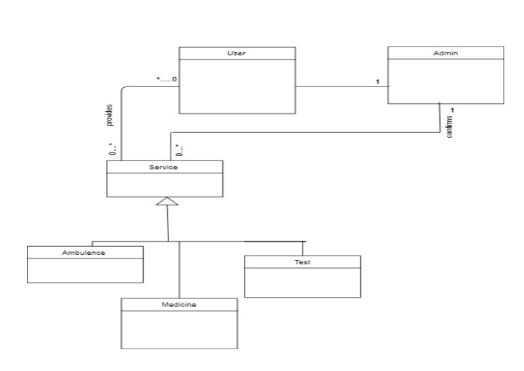
Class diagram:

Slide 8
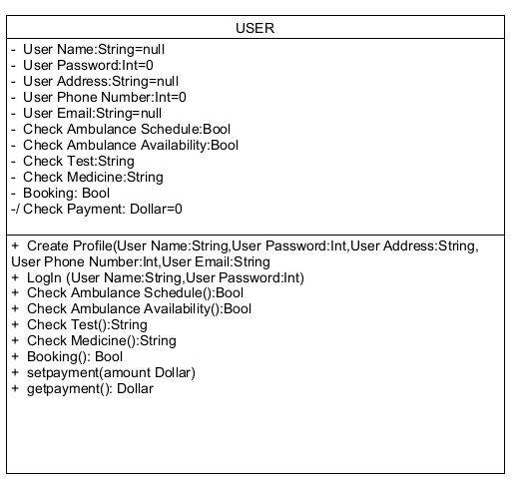
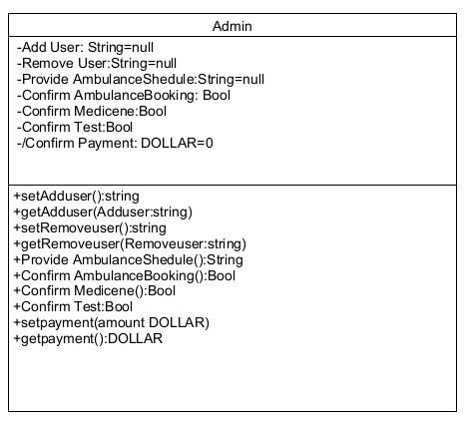
Class compartment:

Slide 9
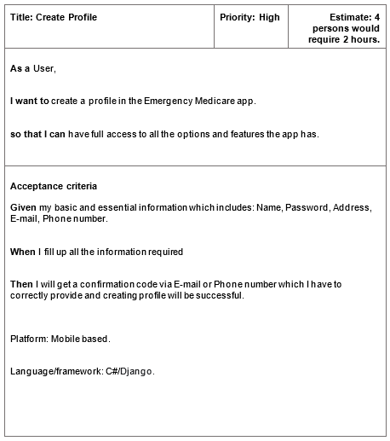
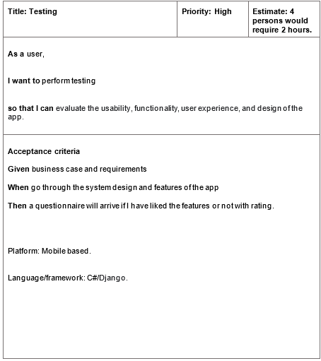
User Story Card:

Slide 10
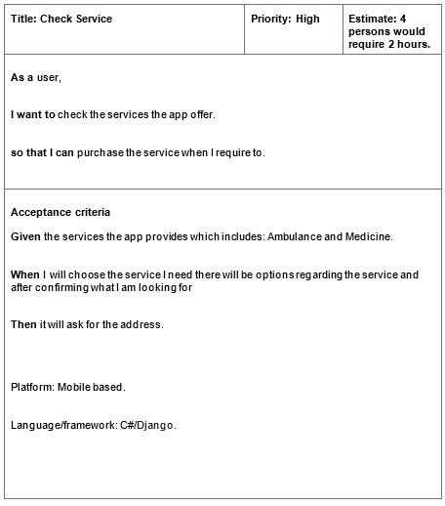

User Story Card:

Slide 11
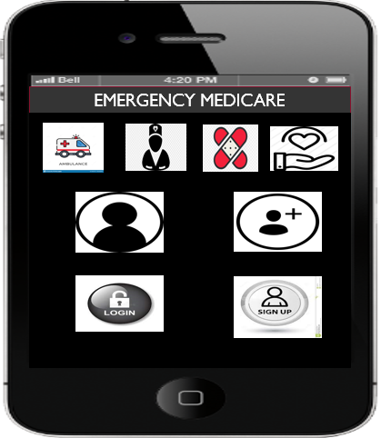
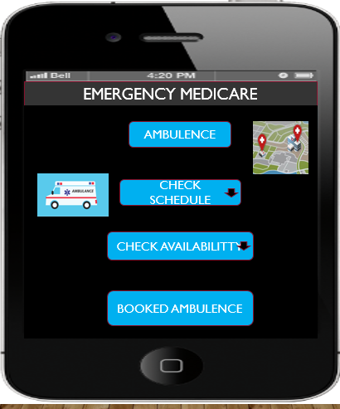
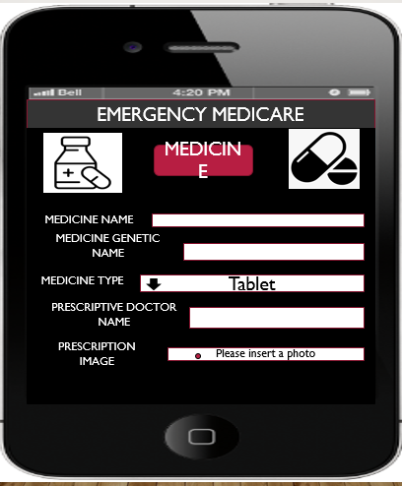
UI DESIGN:

Slide 12
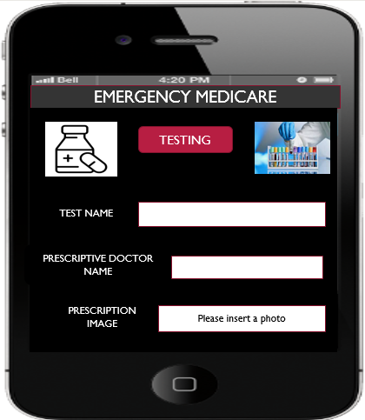
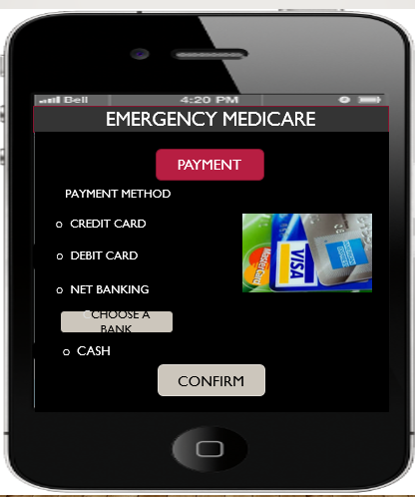
UI DESIGN:

Slide 13
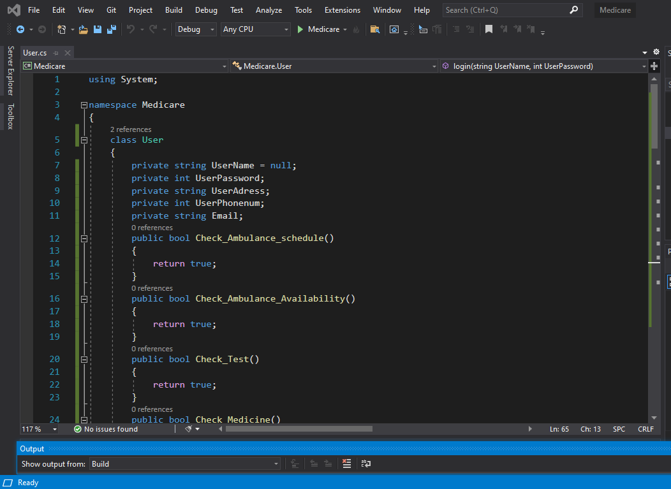
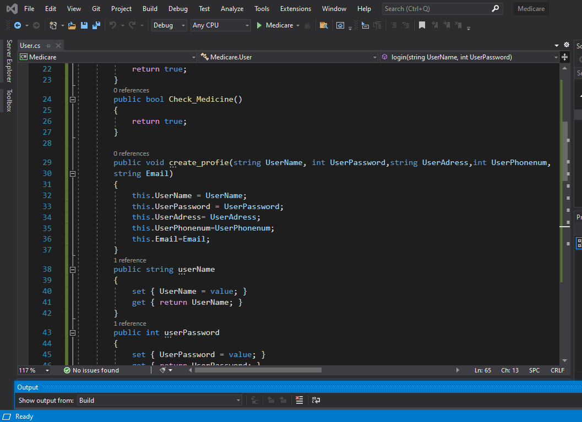
Project Code:

Slide 14
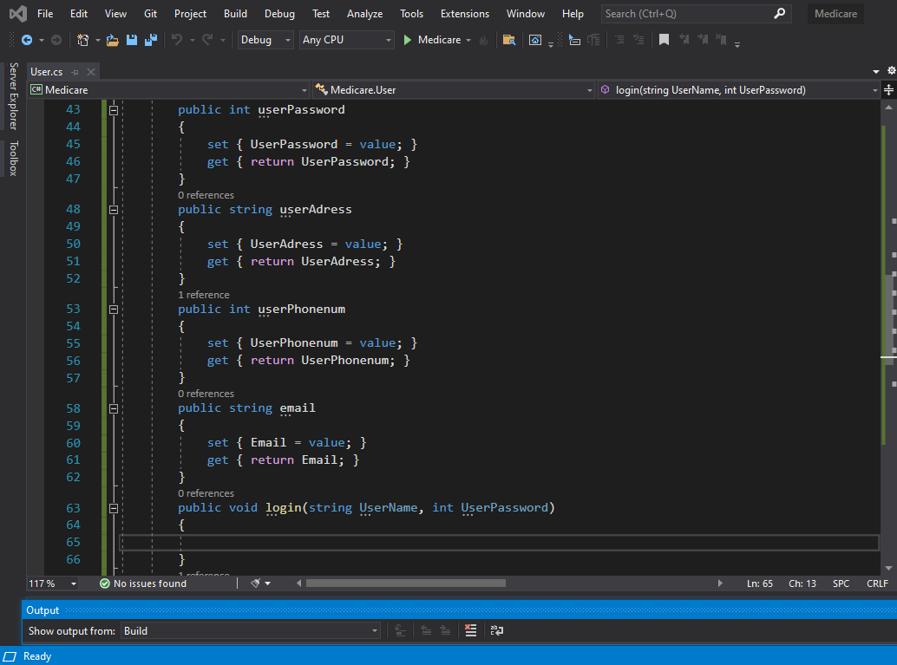
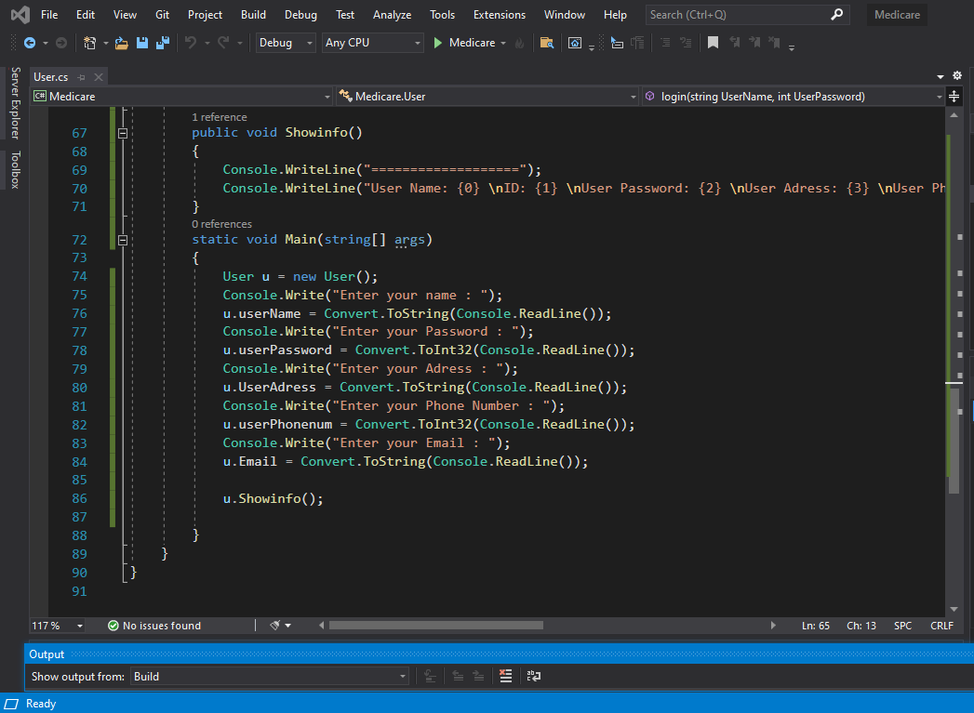
Project Code

Slide 15
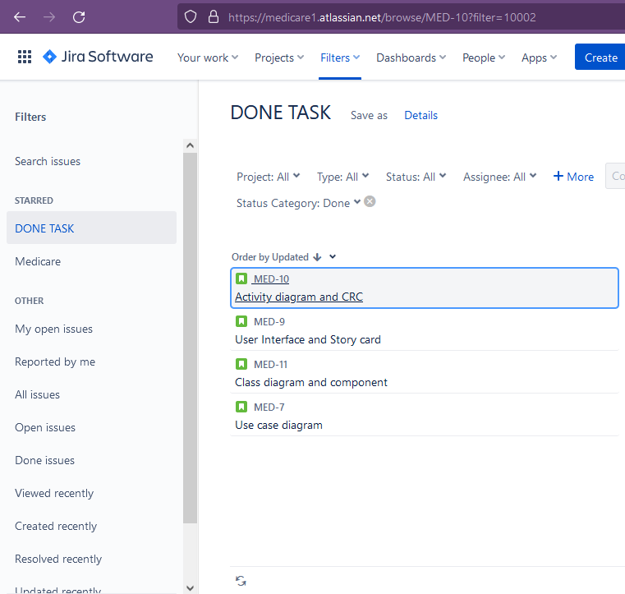
JIRA ISSUES:

Slide 16
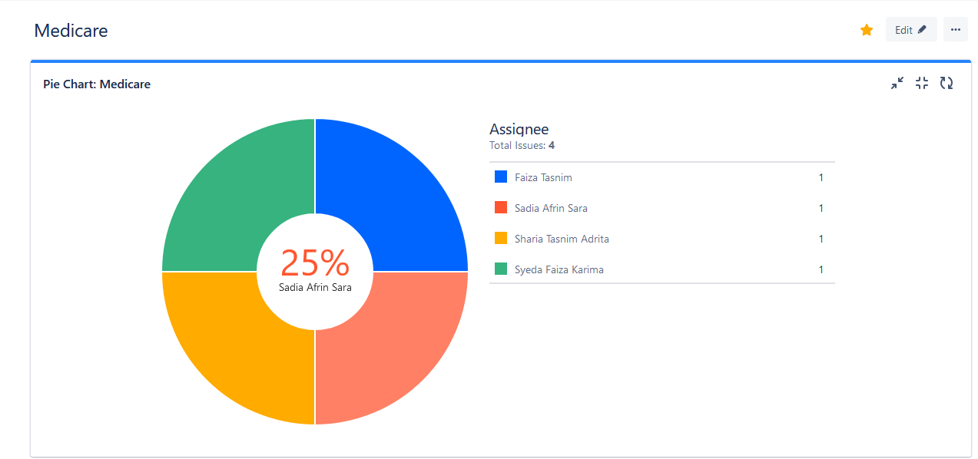
JIRA CONTRIBUTION PIE CHART:

Slide 17
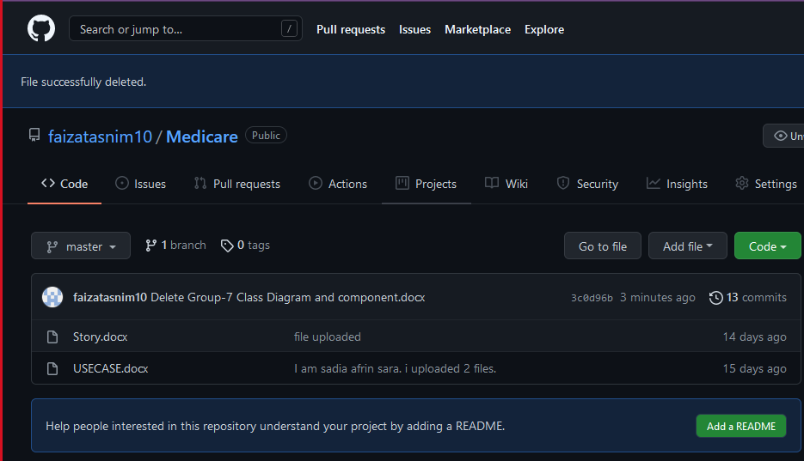
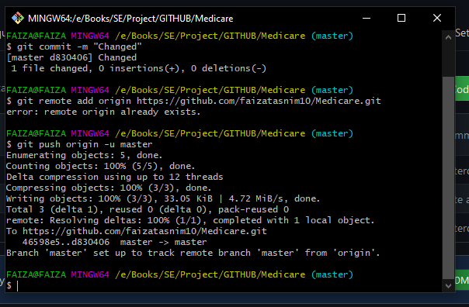
GIT:

Slide 18
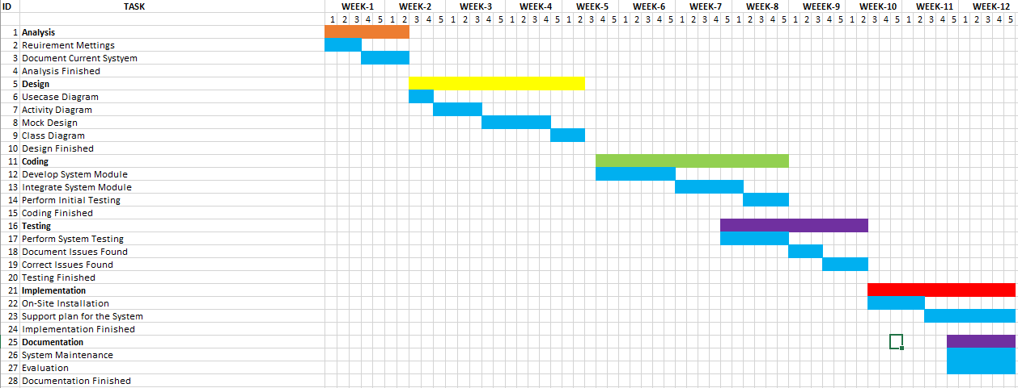
Project scheduling

Slide 19
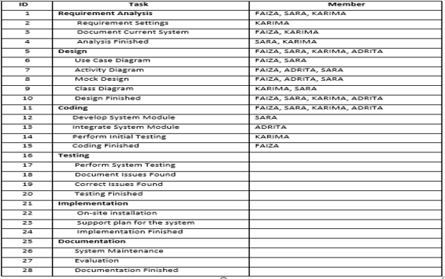
Project scheduling

Slide 20
Constructive Model for Emergency Medicare System:
Project type: Semi-detached
SLOC = 10000
Coefficient<effort factor> =3
P= 1.12
Effort= PM= Coefficient<effort factor> *(SLOC/1000) ^P
=3*(10000/1000) ^1.12 =39.54
Development Time= DM= 2.50*(PM)^T
=2.50*(39.54) ^0.35=9.05
Required number of people =ST= PM/DM = 39.54/9.05=4.36

Slide 21
Budgeting:
Development salary 9 month: Considering 600 taka per developer
600*1584=950400 taka
Requirement analysis: Hourly=400 taka
Analysis expense=400*176=70400 taka
Transportation cost: 15500 takas
Training and hardware cost: 150000 takas
Rent expense: 18000*9=162000 taka
Total utilities: 60000 takas
Maintenance cost: Expense per hour =1500 taka
Extra hour needs for maintenance 80 hours
Total maintenance = 80 * 1500=120000 taka
Other human resource: Project manager = 1* 28000*9=252000 taka
Accountant = 1* 22000*9=198000 taka
Technical staff = 2* 15000*9=270000 taka
Total cost= 252000+198000 +270000=720000 taka
Total estimate expense: 950400+70400+15500+150000+162000+60000+120000+720000=2248300 taka
Profit: 2248300*25%= 562075taka
Final project budget: 2248300+562075=2810375 taka

Slide 22
Conclusion:
Our motive to building this project has two significant purpose which are helping those patients who needed emergency Ambulance and Medicine which our country’s any service can hardly ensure, and to generate a good amount of revenue by helping people. If this project works out perfectly, a huge number of people will be benefited, and we can save valuable life.
- Every Life Matters.

Slide 23
THANK YOU

